Slide 1
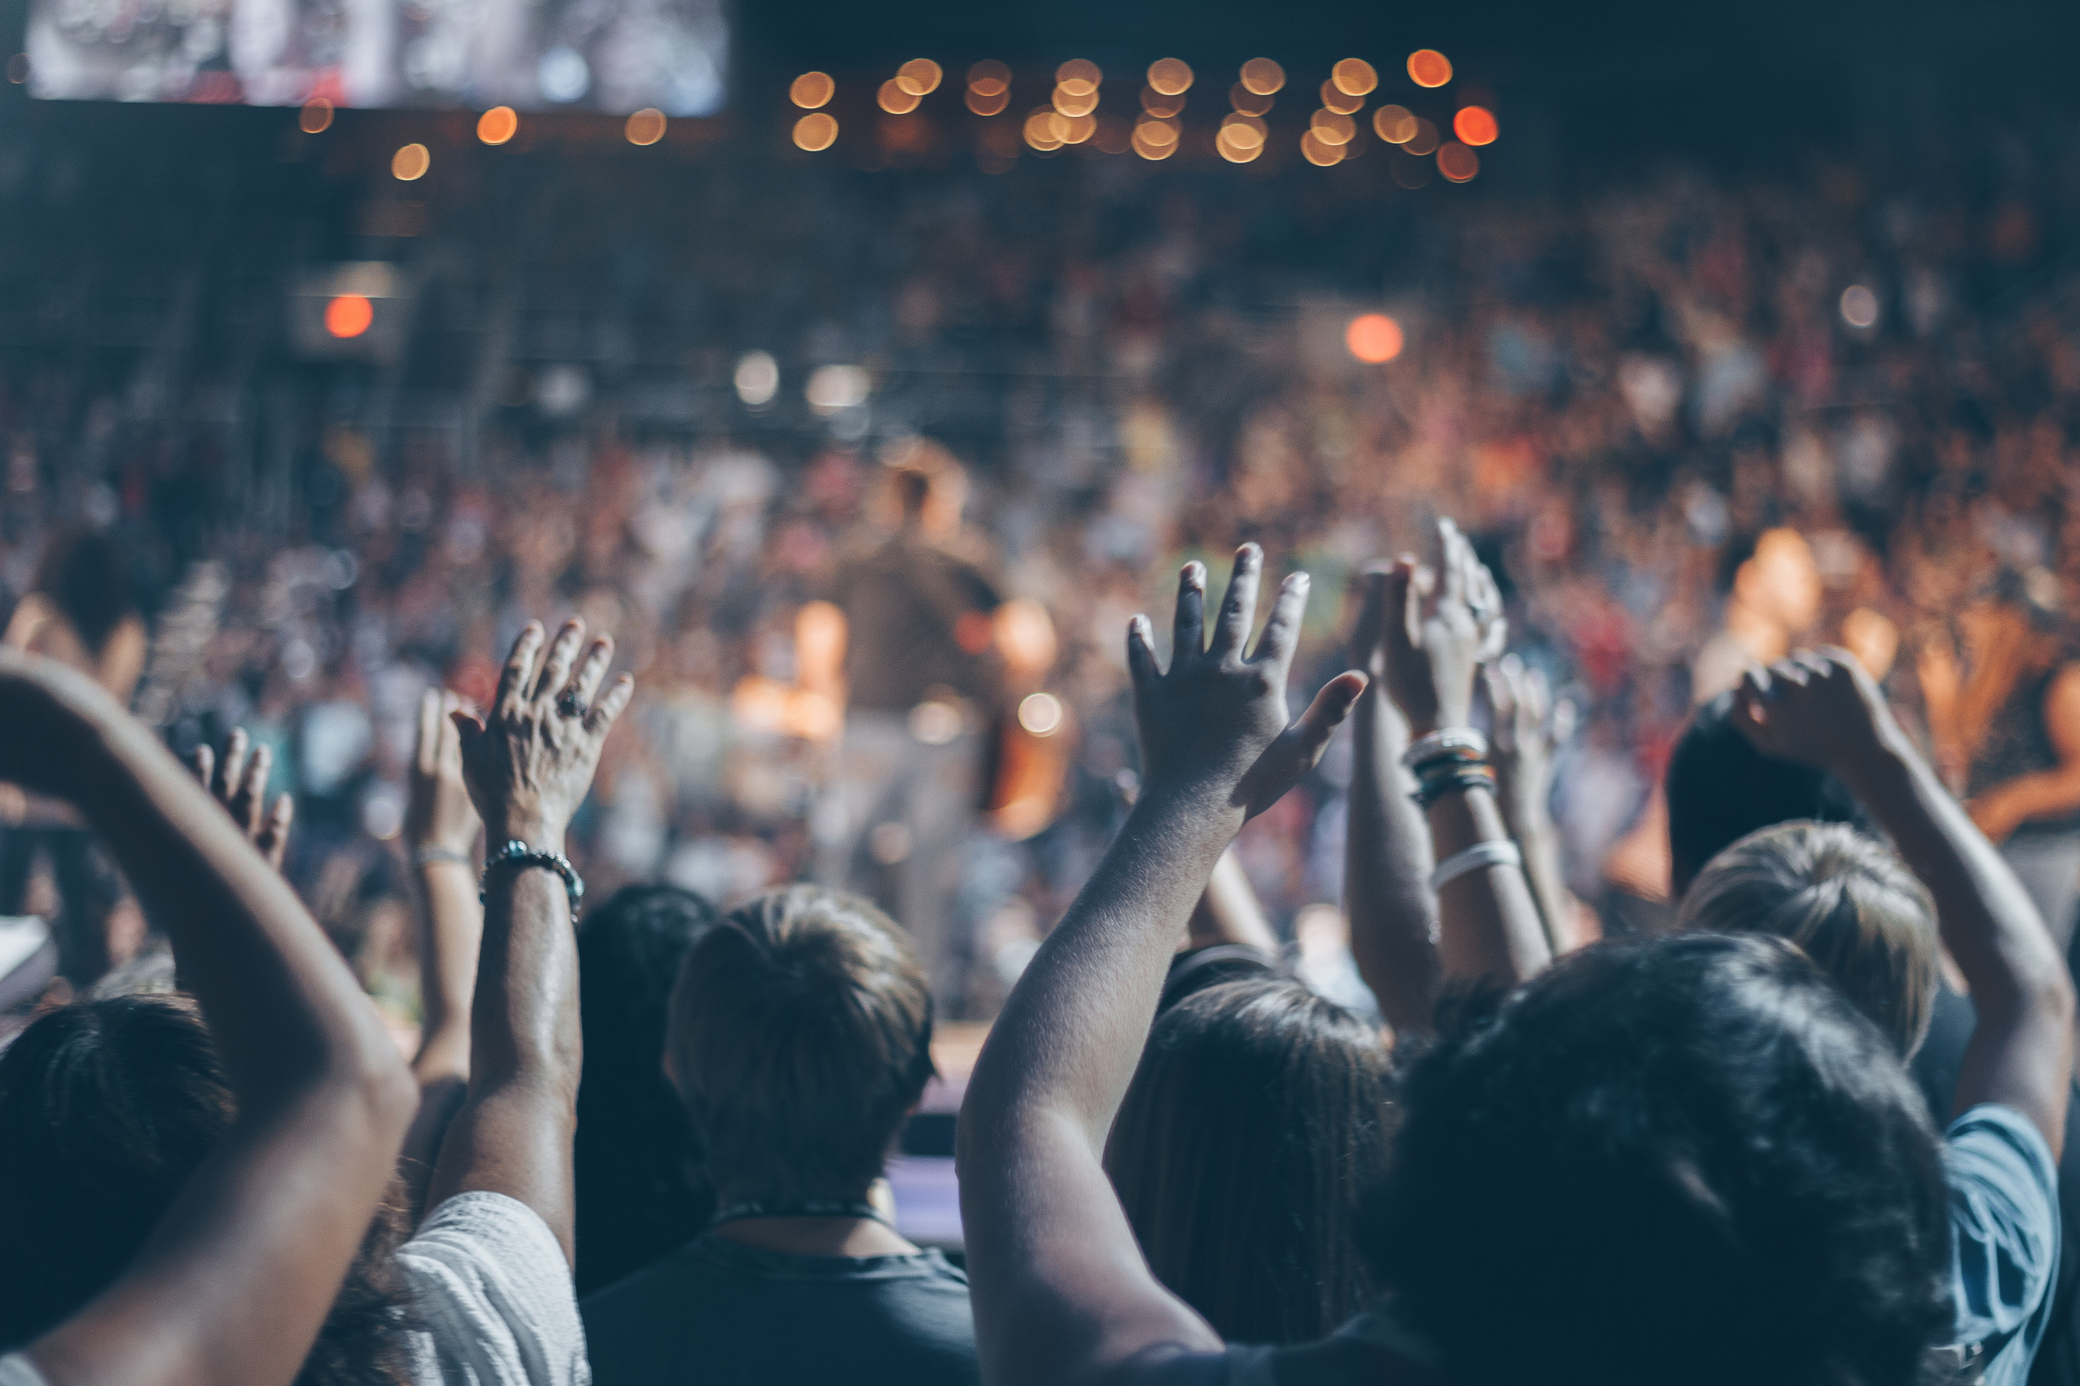
SWIPE TO YOUR NEXT EVENT

Slide 2

With…

Slide 3
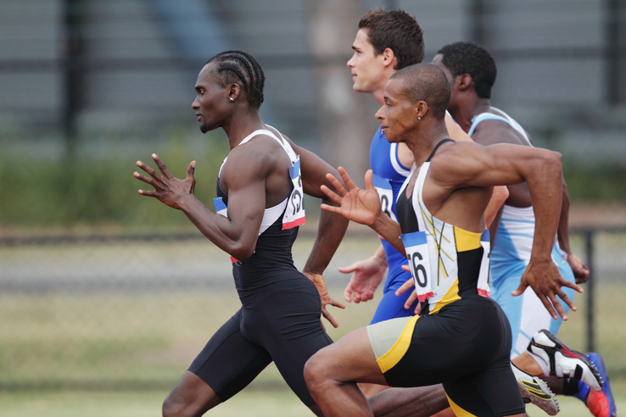

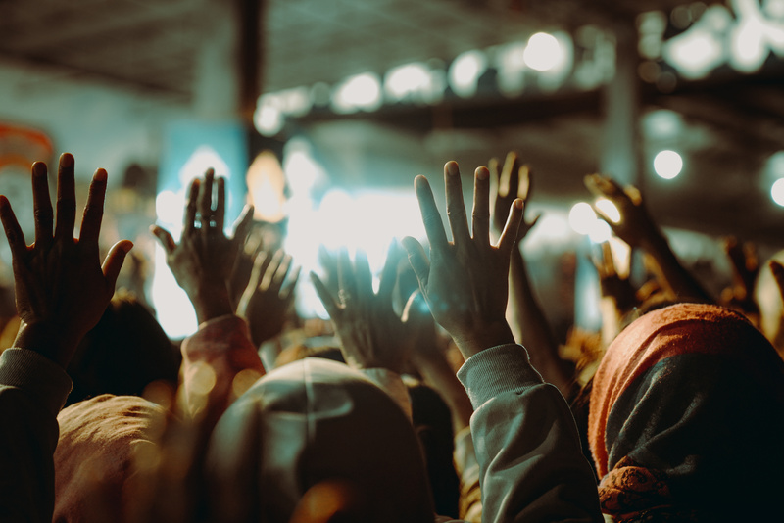

Our idea…
Discover events happening in Heilbronn
Sport
Add friends, connect with others, and invite them to your own events
Easily organize and share your own activities
Party
Find out who is participating
Use filters to find events that match your interests.
Konzerts

Slide 4

Thanks for your attention!

